Slide 1

A Tale of Two Cities
Hakeem & Travis
Notes:
Thank you for joining us today. We are pleased to share with you, our evaluation of some of the most successful years of the Portland Trail Blazers and Golden State Warriors basketball teams.

Slide 2
The best of times…
The draft for our newly established expansion team is looming. We will showcase two renowned basketball teams; the Golden State Warriors and the Portland Trail Blazers. These teams serve as the statistical framework for defining what success looks like for our team in the National Basketball Association.
We delve into key insights to assist you in selecting the perfect players for our franchise. We will outline a formula for what success can look like for our team.
We will showcase the tremendous success of these teams from 2010 through 2022. This includes four championships by the Golden State Warriors and eight consecutive playoff appearances by the Portland Trail Blazers.
From these teams, we have outlined an ideal model for our new team and identified what is necessary to avoid falling short of expectations.
We must examine key statistics from these storied franchises to understand what it takes to build a successful team and pursue a championship.
Notes:
We can just read out this slide. Not thinking we need key notes here.
The last line is “The Big Idea”
1-2 minutes

Slide 3
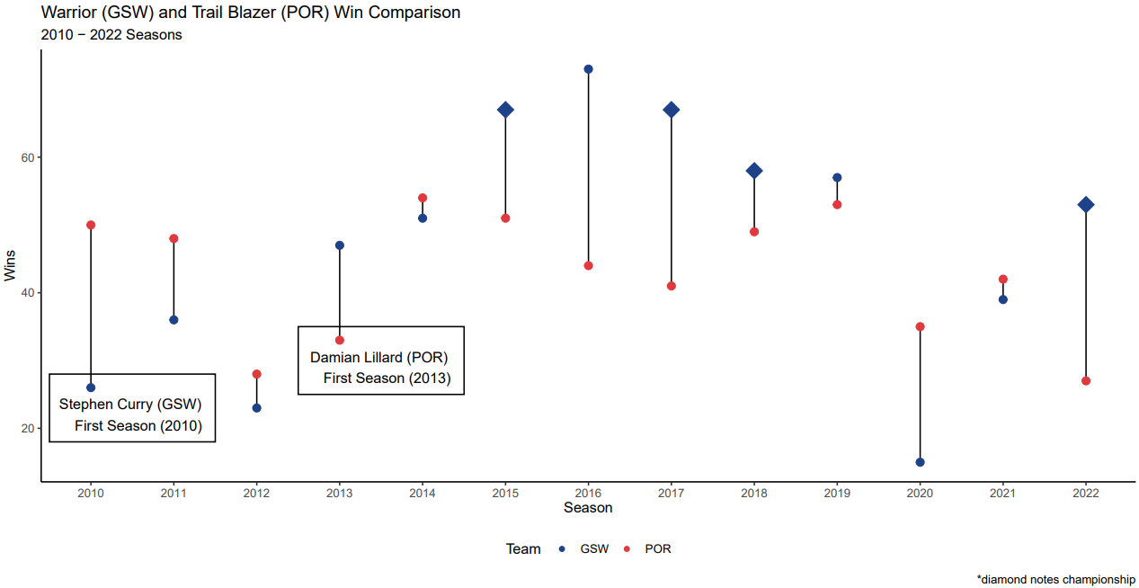
Data - Kaggle (NBA Stats (1947-present)
Notes:
With this graph you can see the number of wins each team accumulated from the 2010-2022 seasons. The Warriors are noted in blue, the Blazers in red. This was highlighted by four championships secured by the Golden State Warriors. The season is noted by the year that the season concluded in. We selected a start for our analysis in 2010 because this coincided with the drafting of Stephen Curry by the Warriors ahead of the 2009-2010 season. This coincides with the winding down of a period of success by the Trail Blazers, who sputtered into 2012 and drafted Damian Lillard ahead of the 2012-2013. Damian Lillard went on to win Rookie of the year. Golden State returned to the playoffs that same year.
Golden State was able to successfully draft and trade for key players, building around their cornerstone guard. Portland struggled to secure the necessary pieces to achieve the pinnacle of team success, in spite of valiant playoff efforts over the years. The would meet in the playoffs three times, with the Warriors handily winning all three matchups.
Upon careful analysis of the data, it becomes evident that emulating a drafting/trading/free-agency strategy akin to that of the Warriors results in a notable and consistent upward trend in the number of wins over the years. The graph distinctly showcases the positive impact of such a team-building approach, emphasizing the potential for sustained success and performance excellence in the realm of professional basketball.
Steve Kerr started coaching Warriors in 2014. Draymond Green drafted in 2013 too. Kevin Durant joined the team for the 2016/2017 season.
Terry Stotts started coaching Blazers for the 2012-2013 season through 2020-2021. Lamarcus Aldridge left after 2014/15 season
2-3 minutes

Slide 4
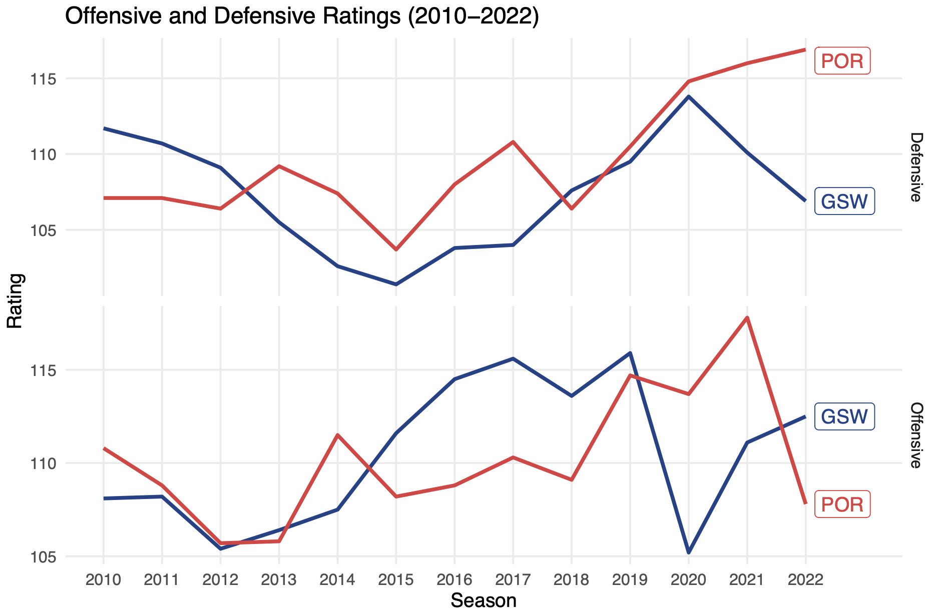
Data - Kaggle (NBA Stats (1947-present)
Notes:
We present a line graph that serves as a comparative analysis of offensive and defensive ratings between the two teams. The x-axis showcases the offensive rating, while the y-axis illustrates the defensive rating. This visual representation provides a clear and concise overview, allowing for a direct comparison of how each team performs in both offensive and defensive aspects. The graph is a valuable tool for gaining insights into the overall team dynamics and strategic strengths of the featured teams in relation to their offensive and defensive capabilities.
Notice that the Warriors in their Championship years leads over Portland in Offensive rating.

Slide 5
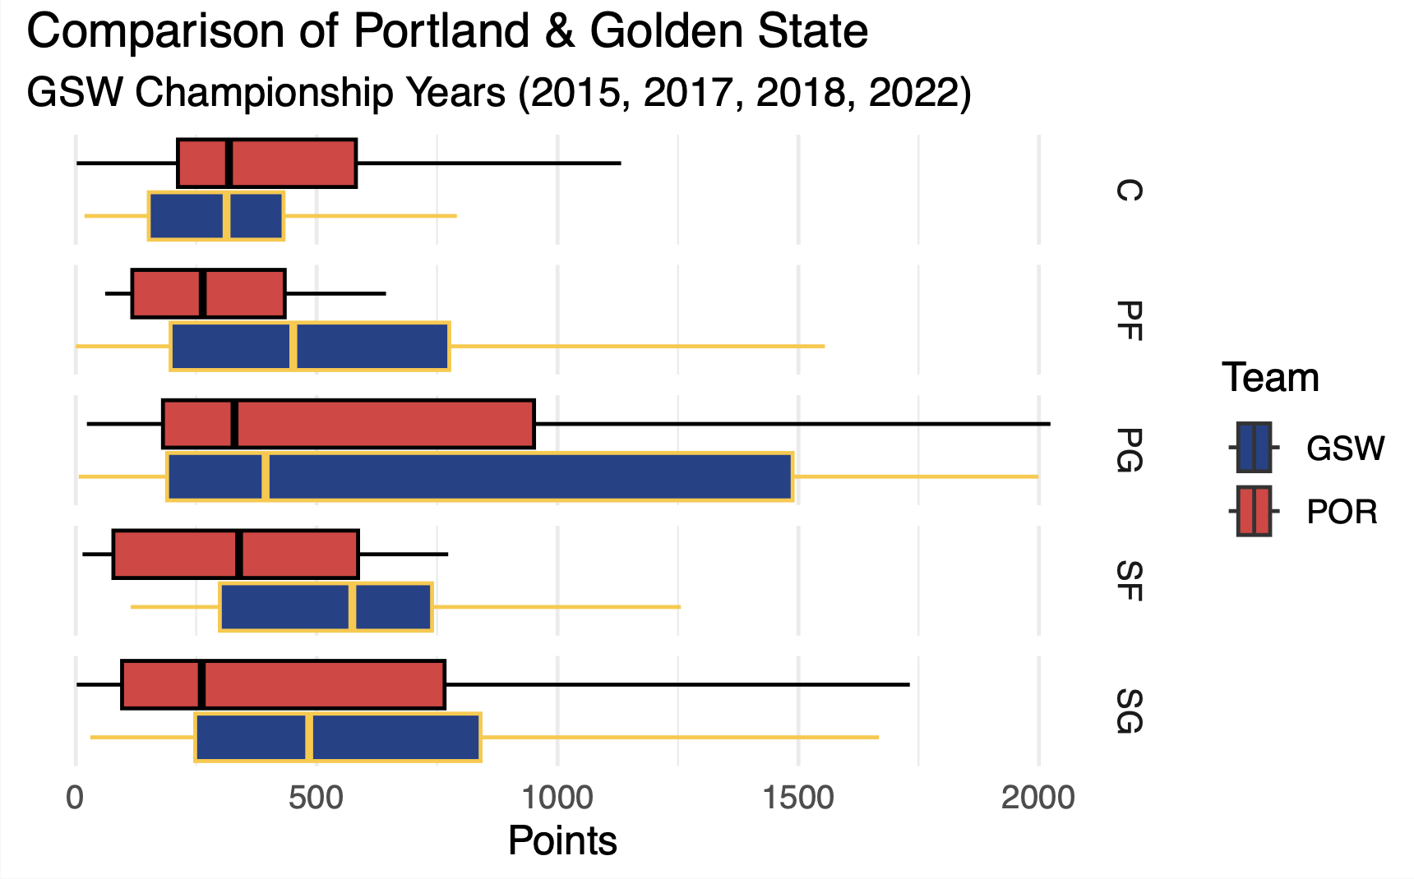
Data - Kaggle (NBA Stats (1947-present)
Notes:
In the next slide, we shift our focus to a boxplot representing the points scored during the four championship-winning seasons by the Warriors. This insightful visualization breaks down the scoring performance, drawing comparisons between the Warriors and the Blazers and further distinguishing the data by player position. By examining these nuanced details, we gain valuable insights into the offensive dynamics that contributed to the Warriors' success across multiple seasons.

Slide 6
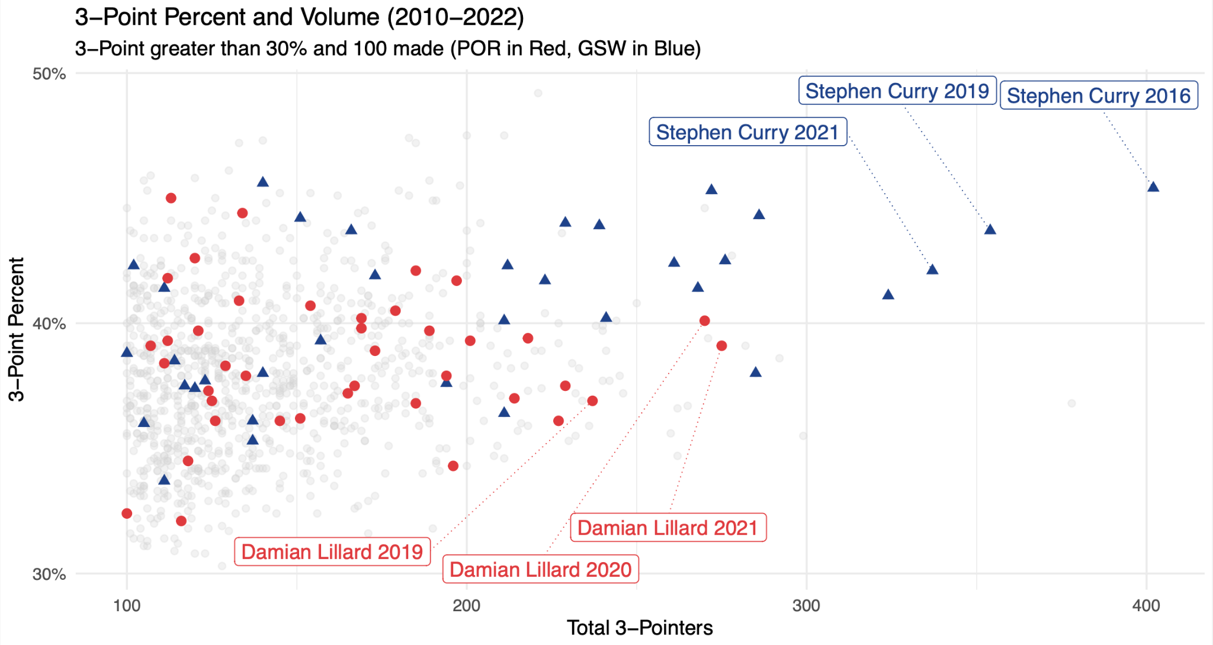
Data - Kaggle (NBA Stats (1947-present)
Notes:
Our attention turns to a point graph that illuminates the total number of three-pointers made by players on the focus teams. Notably, we've highlighted the remarkable three-point contributions of players such as Steph Curry and Damian Lillard, showcasing their prowess by illustrating the total threes hit per season. This visual presentation offers a comprehensive view of the sharpshooting abilities that have played a significant role in the success of these standout players.
This graph does include all performances within the NBA from 2010-2022 for players shooting the three point shot at a success rate of at least 30% and with more than 100 successful attempts. Our graph allows us to see the impact of having effective 3 point shooters in the modern NBA. This is one of the cornerstones of small ball, which is an area of focus for our analysis.
This graph clearly shows that the Warriors and Blazers were among the top performers in this key metric during this era. While Damian Lillard is an elite 3 point shooter, Stephen Curry has demonstrated unprecedented skill. Both are generational talents.

Slide 7
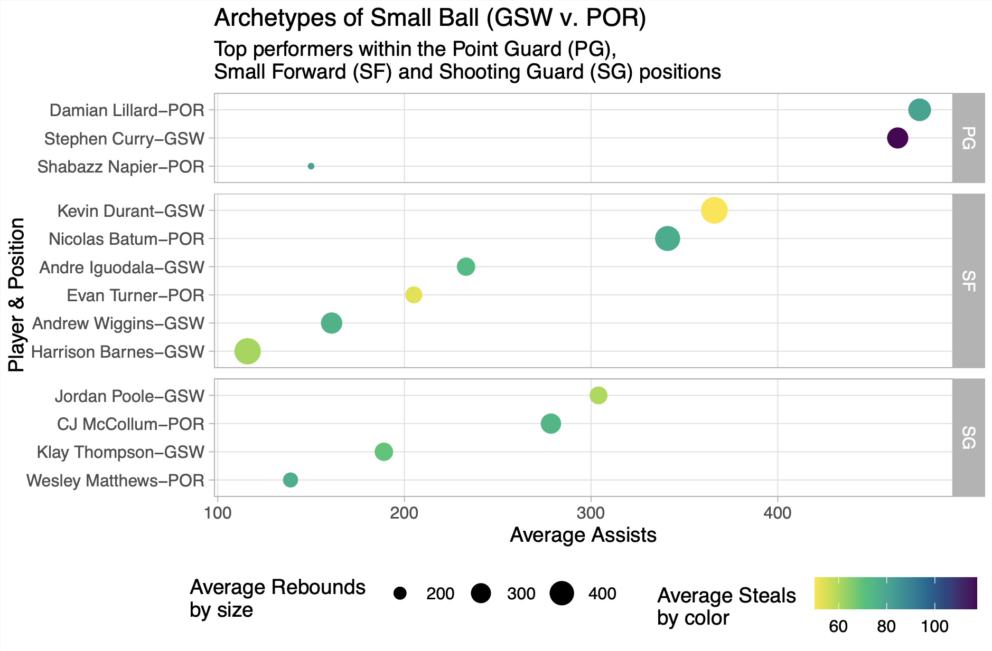
Data - Kaggle (NBA Stats (1947-present)
Notes:
In addition to focusing on the ability to shoot the three and score points at a high volume, the positions of our focus must be able to contribute across all statistical fields. Specifically assists
We shed light on the strategic implementation of small-ball tactics by both the Warriors and Blazers. The graph, structured with average assists on the x-axis, is thoughtfully faceted by player position. The color scheme provides insight into the defensive prowess, as it is color coded by the number of steals. Furthermore, the size of the bubbles emphasizes rebounding. This visual representation aims to capture the multifaceted impact of small-ball strategies employed by the Warriors, offering a nuanced perspective on both offensive and defensive aspects across different player roles.
We again see the striking level of performance by Damian Lillard and Stephen Curry. Both performing not just in the top of their positions, but also holding their statistical ground against other comparable positions.
We can see that for the majority of these three positions, and for the player to have a recognizable impact in our desired system, they must be able to more than score. They must be able to facilitate points through others, by way of the assist. They must be able to rebound and preserve possessions. They must be able to steal and provide a defensive presence at the top of the court.

Slide 8
Key Takeaways - Draft, Trade and Sign
1. Point Guard Excellence:
Exceptional point guard with a high caliber shot (e.g., Stephen Curry, Dame Lillard).
Impressive 3-point shooting at or above 41%.
Proficient in creating scoring opportunities for teammates.
2. Versatile Shooting Guard:
Shooting guard role mirrors or closely aligns with the point guard (e.g., Klay Thompson, CJ McCollum).
3. Dynamic Small Forward:
Small forward makes a significant impact on both defense and offense (e.g., Andre Iguodala, Kevin Durant, and Nicolas Batum).
4. Swiss Army Knife Power Forward:
Power forward serves as a versatile asset (e.g., Kevin Durant, Draymond Green).
5. Adaptable Center:
Center excels in small-ball situations, guarding multiple positions, and contributing to offense (e.g., Draymond Green).
6. Strategic Coaching:
Coach demonstrates a strong offensive mindset, effectively utilizing player talents (e.g., Stotts, Kerr).
7. Dynamic Bench Support:
Supporting cast on the bench capable of scoring and complementing the point guard (e.g., Evan Turner, Harrison Barnes, Wesley Matthews).
Notes:
We can just read out this slide. Not thinking we need key notes here.
The last line is “The Big Idea”
1-2 minutes

